Slide 1



UCI ITALY AIR QUALITY UNIVARIATE LINEAR REGRESSION MODELLING
IRONHACK DAFT AUG22 “Data Analytics” Midterm Project Presentation
Team Member: Rodrigo Franco, Gunnar David
CONFIDENTIAL

Slide 2
AIR QUALITY UNIVARIATE AND MULTIVARIATE PREDICTION WITH DEEP LEARNING CNN-LSTM-ML
IRONHACK DAFT AUG22 “Data Analytics” Midterm Project Presentation
AI/ML Senior Strategists/ Product Manager: Gunnar David
CONFIDENTIAL

Slide 3
General guidelines for the presentations:
7 min presentation + 5 min Q&A (+1 min for the Elisabeth, Rodrigo, Paul and Esra)
Introduce the research/business question/hypothesis you're trying to answer/test and the type and the objective of the study (descriptive, predictive, BI...);
High-level description of the data you have in hand, supported by meaningful plots/tables (size, quality of the data, how's it distributed, etc.);
Insights/Findings:
show only the charts that make sense and have interesting/unusual/meaningful patterns;
every chart/plot need a title and legend;
Data processing pipeline;
describe the features used for the modeling and the algorithms used ( Modeling project);
Outcome & Results (e. g. conclusions, model interpretation, the answer to the research question/hypotheses, etc.);
Outlook (e. g. limitations, next steps, learnings, etc.)
Remember: great presentation = content + design + delivery.
!

Slide 4


Meet the UCI AQ Team!
Rodrigo Franco
Home Country: Paraguay
Post-Ironhack Industry: Consulting
Programming Language: Python
Gunnar David
Home Country: Germany
Post-Ironhack Industry: Consulting
Programming Language: Python, R, JavaScript, HTML5 & CSS3

Slide 5

Friday, the 09th of September Time: 12:15 – 12:30 CEST [Click] Zoom Call

Slide 6

Green Belt Tollgate Review
Define Phase

Slide 7
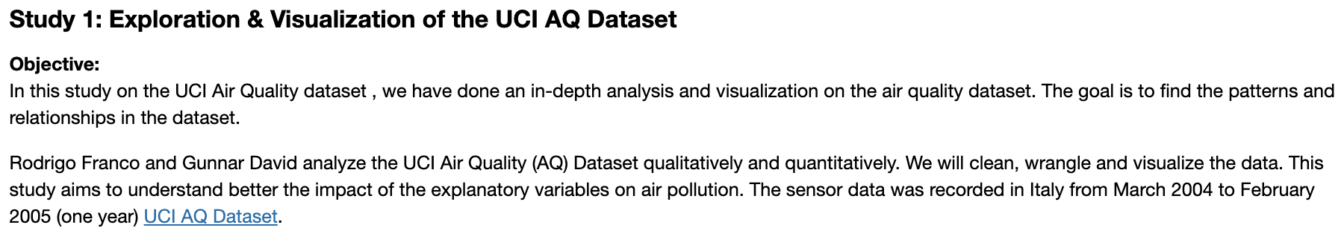
Development Specification
Full DSD click here

Slide 8
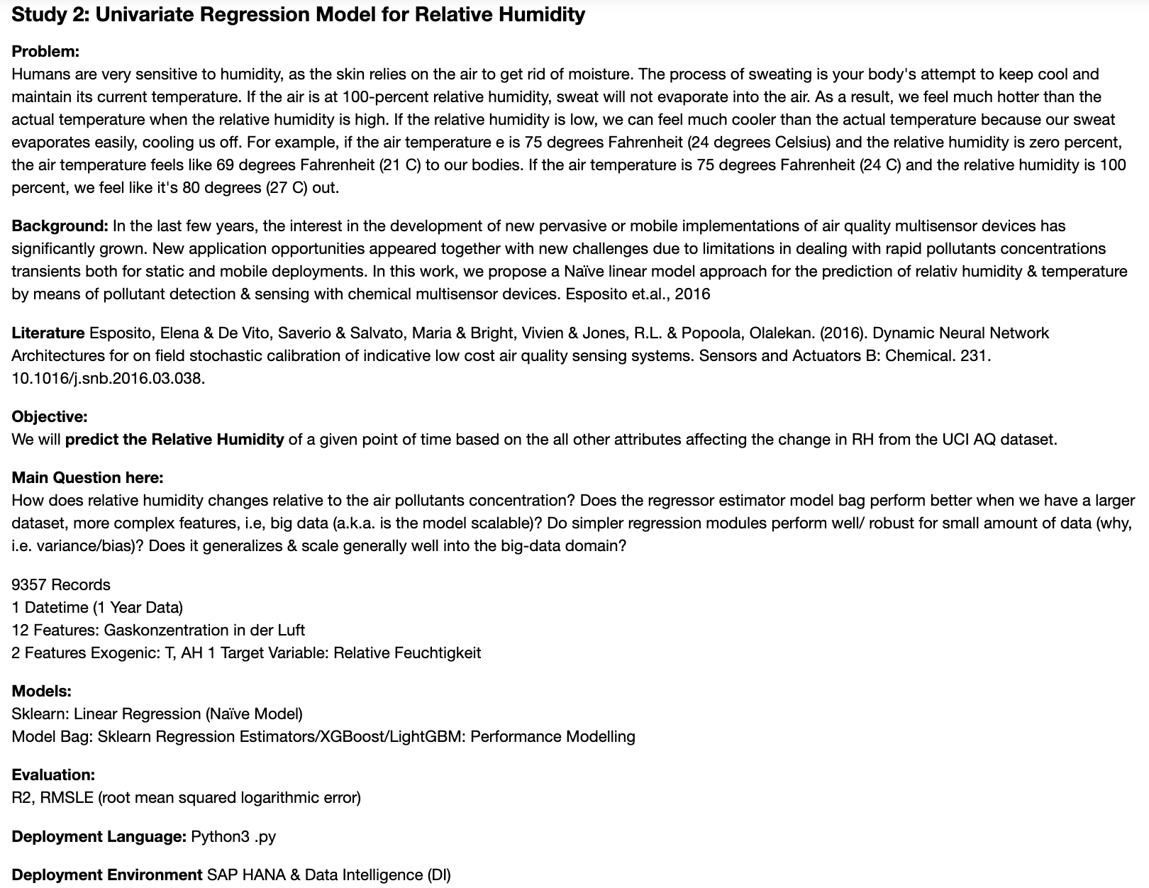
Development Specification Cont`
Full DSD click here

Slide 9
Contents
Project Overview
Objective
Data preview
Analytics Roadmap
Analysis process
Key Findings
Regression models
Output
Visualization
Observations
Recommendations

Slide 10

Project Overview

Slide 11




Overview BIG Questions
How does relative humidity (RH) changes statistically and linearly with the air pollutant concentration?
What important factors impact RH and how?
How would the RH linear regression model scale with AQ big data? Is the RH linear regression model sufficient for the objective?
What is the optimal predictive model for RH from AQ data?

Slide 12
Introduction to the Research
UCI Air Quality Study
Define Phase
Study 1: Exploration & Visualization of the UCI AQ Dataset
Objective:
In this study on the UCI Air Quality dataset , we have done an in-depth analysis and visualization on the air quality dataset. The goal is to find the patterns and relationships in the dataset.
Rodrigo Franco and Gunnar David analyze the UCI Air Quality (AQ) Dataset qualitatively and quantitatively. We will clean, wrangle and visualize the data. This study aims to understand better the impact of the explanatory variables on air pollution. The sensor data was recorded in Italy from March 2004 to February 2005 (one year) [UCI AQ Dataset](https://archive.ics.uci.edu/ml/datasets/air+quality).
Summary report: UCI AQ Data Analysis Report

Slide 13
Introduction to the Research
UCI Air Quality Study
Define Phase
Study 2: Univariate Regression Model for Relative Humidity
Problem:
Humans are very sensitive to humidity, as the skin relies on the air to get rid of moisture. The process of sweating is your body's attempt to keep cool and maintain its current temperature. If the air is at 100-percent relative humidity, sweat will not evaporate into the air. As a result, we feel much hotter than the actual temperature when the relative humidity is high. If the relative humidity is low, we can feel much cooler than the actual temperature because our sweat evaporates easily, cooling us off. For example, if the air temperature e is 75 degrees Fahrenheit (24 degrees Celsius) and the relative humidity is zero percent, the air temperature feels like 69 degrees Fahrenheit (21 C) to our bodies. If the air temperature is 75 degrees Fahrenheit (24 C) and the relative humidity is 100 percent, we feel like it's 80 degrees (27 C) out.
Background:
In the last few years, the interest in the development of new pervasive or mobile implementations of air quality multisensor devices has significantly grown. New application opportunities appeared together with new challenges due to limitations in dealing with rapid pollutants concentrations transients both for static and mobile deployments. In this work, we propose a Naïve linear model approach for the prediction of relativ humidity & temperature by means of pollutant detection & sensing with chemical multisensor devices. Esposito et.al., 2016 ^{[1]}
Main Question here:
How does relative humidity changes relative to the air pollutants concentration?
Does the regressor estimator model bag perform better when we have a larger dataset, more complex features, i.e, big data (a.k.a. is the model scalable)?
Do simpler regression modules perform well/ robust for small amount of data (why, i.e. variance/bias)? Does it generalizes & scale generally well into the big-data domain?
^{[1]}Esposito, Elena & De Vito, Saverio & Salvato, Maria & Bright, Vivien & Jones, R.L. & Popoola, Olalekan. (2016). Dynamic Neural Network Architectures for on field stochastic calibration of indicative low cost air quality sensing systems. Sensors and Actuators B: Chemical. 231. 10.1016/j.snb.2016.03.038.

Slide 14
Smart Objective
UCI Air Quality Study
Define Phase
We will predict the Relative Humidity of a given point of time based on the all other attributes affecting the change in RH from the UCI AQ dataset, improving Naïve linear regression baseline performance by 20% using ensemble models.
Also note that perhaps more than one machine learning model is required if results from a single model on all Relative Humidity is not effective.

Slide 15
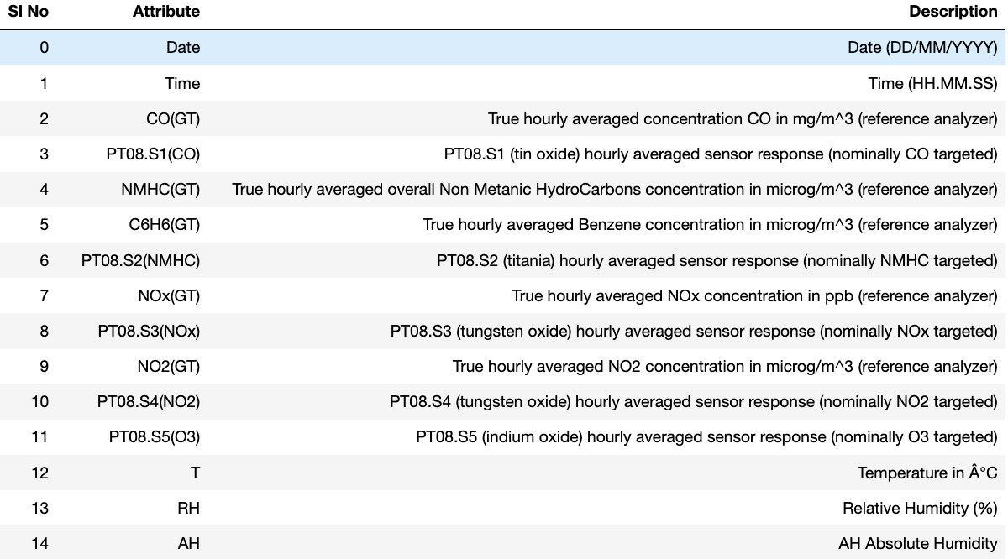
UCI Air Quality Study
Define Phase

Slide 16
Our analysis focuses on all 5 measures and 13 dimensions derived from UCI AQ df, combined with 3 exogenous factors
Averaged concentrations& sensor responses
(hourly entries)
Y-M-D-HH:MM:SS 2004-03-10 18:00:00 2005-04-04 14:00:00
1 Meaningless Variables
NMHC_GT 90.23% NaN
Year Month Hour 4 Seasons, Month Name, Hour
13 Contributing Dimensions
Concentration Detection
(Ground Truth)
Responds
Detection
(Nominally Targeted)
Exogenous Factors:
T, RH, AH
9,357 Rows
3 Segments
15 Columns
Non-Methane Hydrocarbons, Benzene, CO, NOx, O3
10 Pollutants
3 Categories
PT08.S1(CO
3 Exogenous Factors:
Temp
RH
AH
PT08.S2(NMHC
Sensor Responds (Proxy to Gases
which are measured by their concentration
5 Measures
T08.S3(NOx
PT08.S4(NO2)
1 Temporal Factors:
Datetime
PT08.S5(O3)

Slide 17
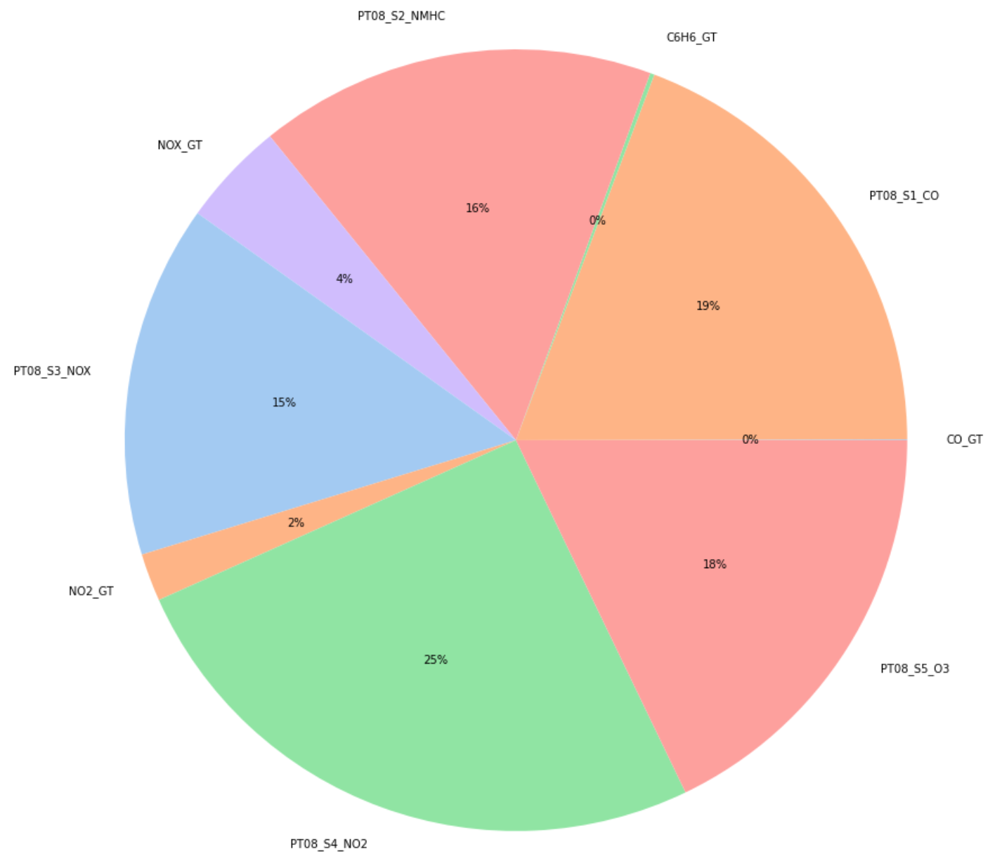
Share of AQ Pollutants
UCI Air Quality Study 1
Measure Phase
Key Findings:
Each slice of the pie chart represents the mean of concentration of a gas throughout the year. Concentration of tungsten oxide (PTO8_S4_NO2) is maximum.
Key Finding:
Recently, new sensing technologies and systems for achieving a truly pervasive air quality (AQ) monitoring capability in cities are being developed.
The primary driver is actually the current coarse grained and sparse AQ measuring mesh that is based on costly and cumbersome conventional analysers.
→ These are challenged by the need for obtaining a detailed and representative map of the true concentrations of pollutants in the city. E. Esposito et.al., 2016
32.3 K
Datetime Length: 2004-03-10 - 2005-04-04
Country: Italy
City: assumed Milan

Slide 18
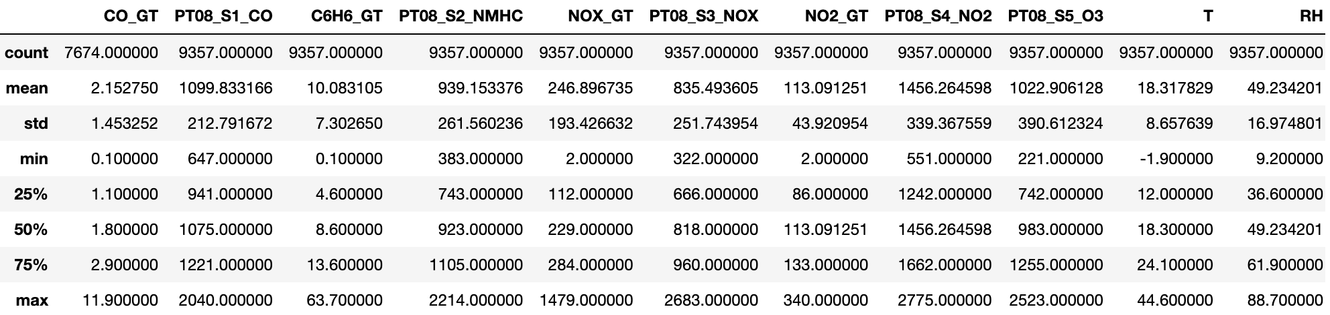

Stats of AQ Pollutants
Slide Reference
Usage: Recommended (although depending on the project, it may not be feasible to conduct a detailed study)
Description: Overview of your MSA findings.
Instructions: Describe the results and findings of your MSA. Show the MiniTab graphical output and discuss key highlights. Populate at the bottom of the page in a clear manner whether the MSA proves or disproves you have valid data.
UCI Air Quality Study 1
Measure Phase
Upload Minitab File

Slide 19
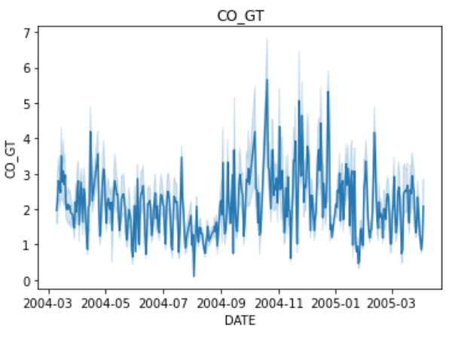
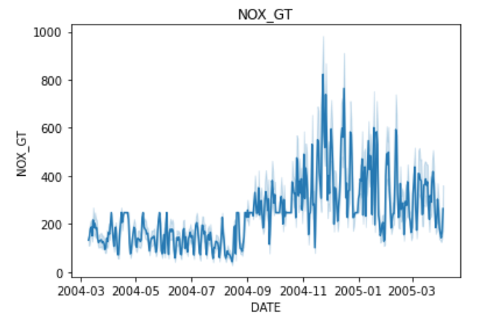
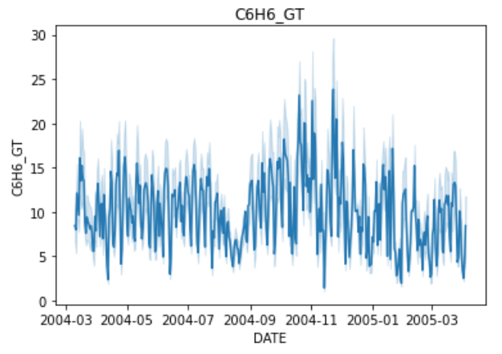
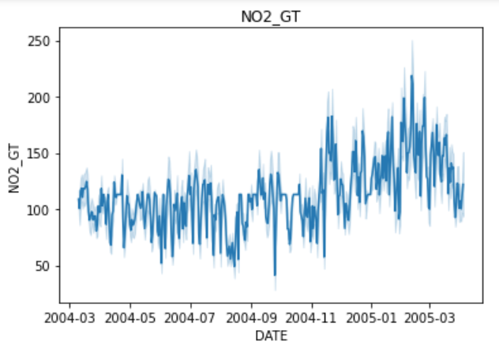
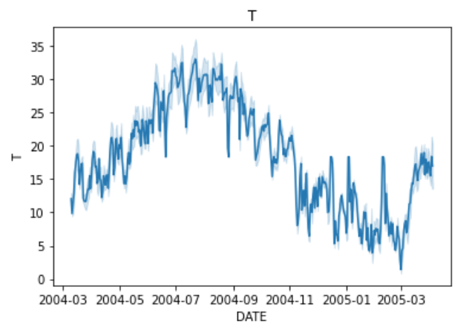
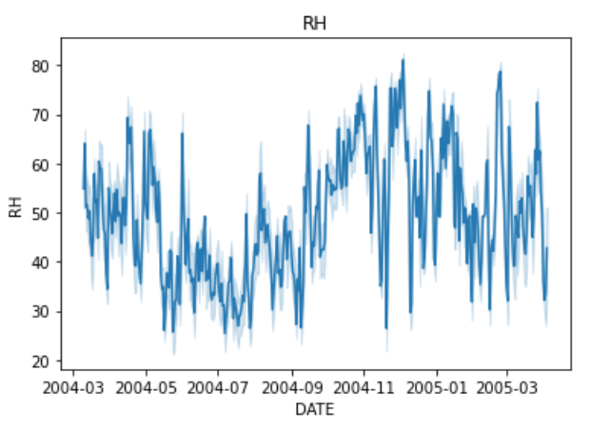
Reference Measurement on Detector
UCI Air Quality Study 1
Measure Phase
Fig.: Plot of reference concentration data (Roof Dataset). The CO concentration data present a seasonality with time and it is not used in this work.

Slide 20
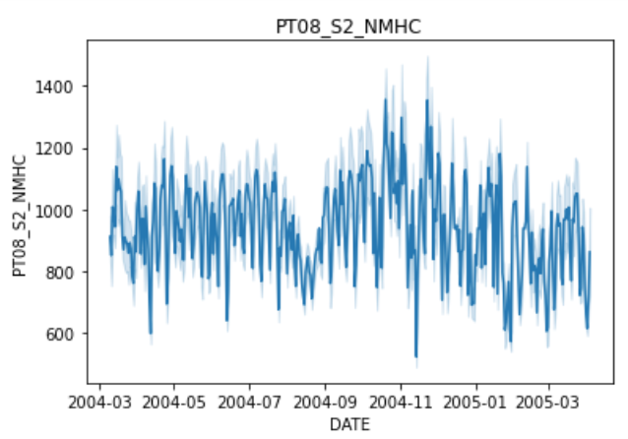
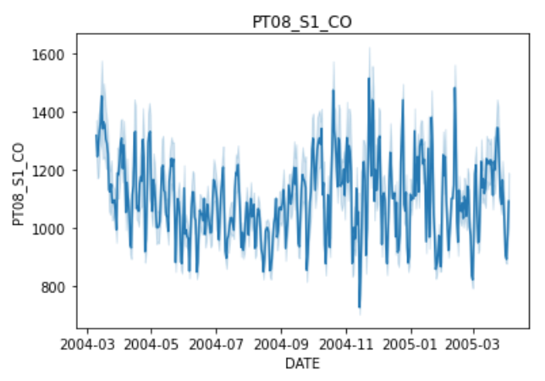
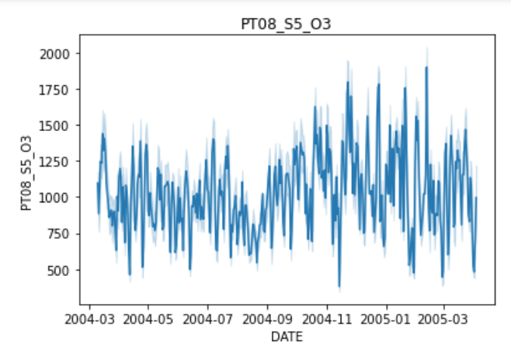
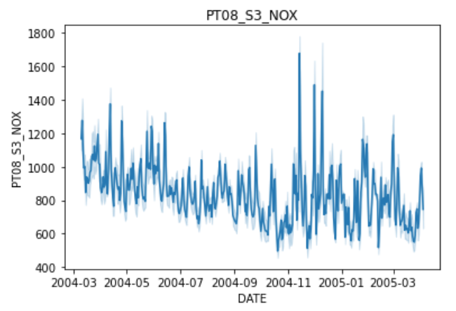
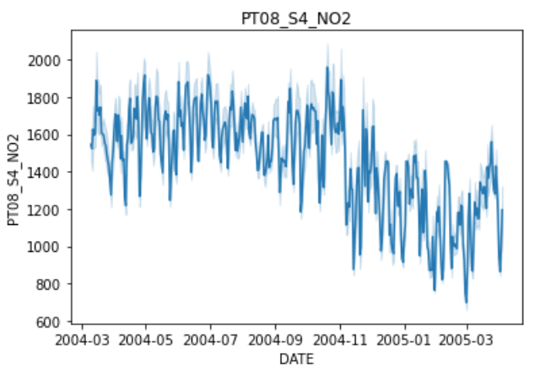
Sensors Measurement on the Detector
UCI Air Quality Study 1
Measure Phase
Fig.: Plot of uncalibrated SnaQ EC Sensors Data (Temperature Correction apply) versus time (seconds), plus Temperature (T) and
Humidity (RH) sensors. The daily oscillation pattern is evident.

Slide 21
Exogenous Variables
UCI Air Quality Study 1
Measure Phase
Fig.: Plot of reference exogenous data. The temperature and relative humidity data present a seasonality with time. RH is the target variable.

Slide 22
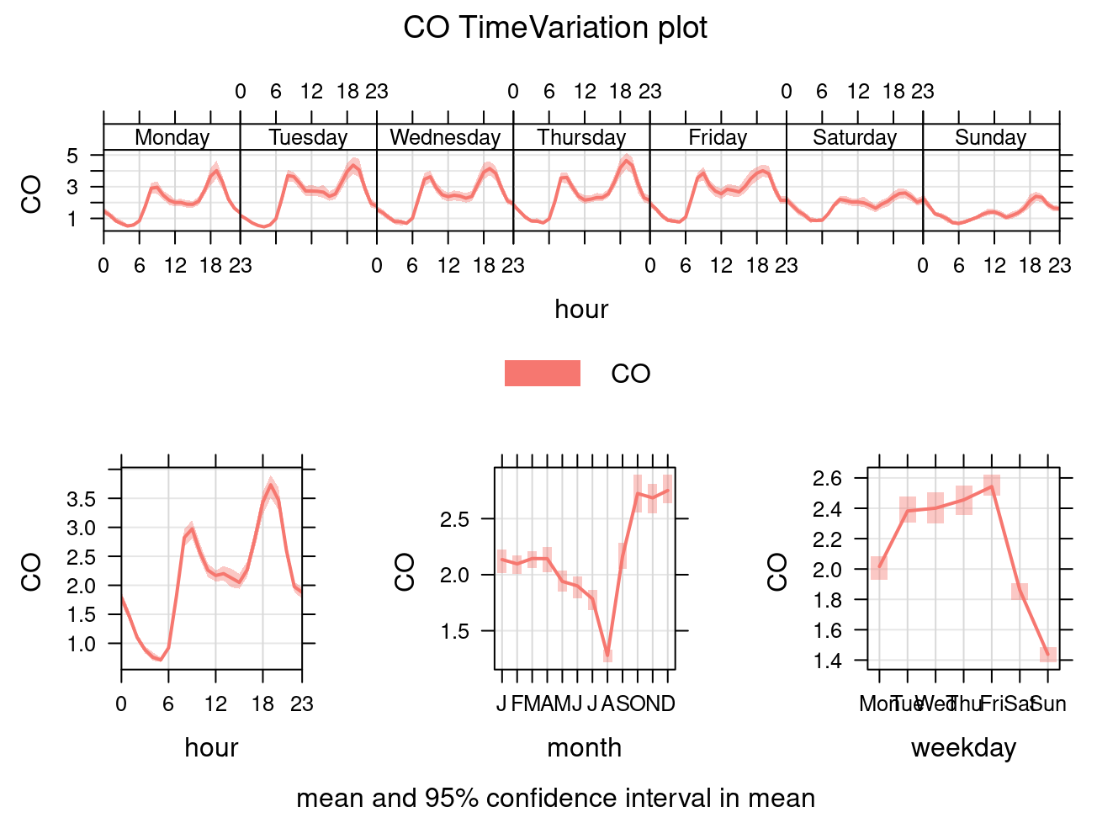
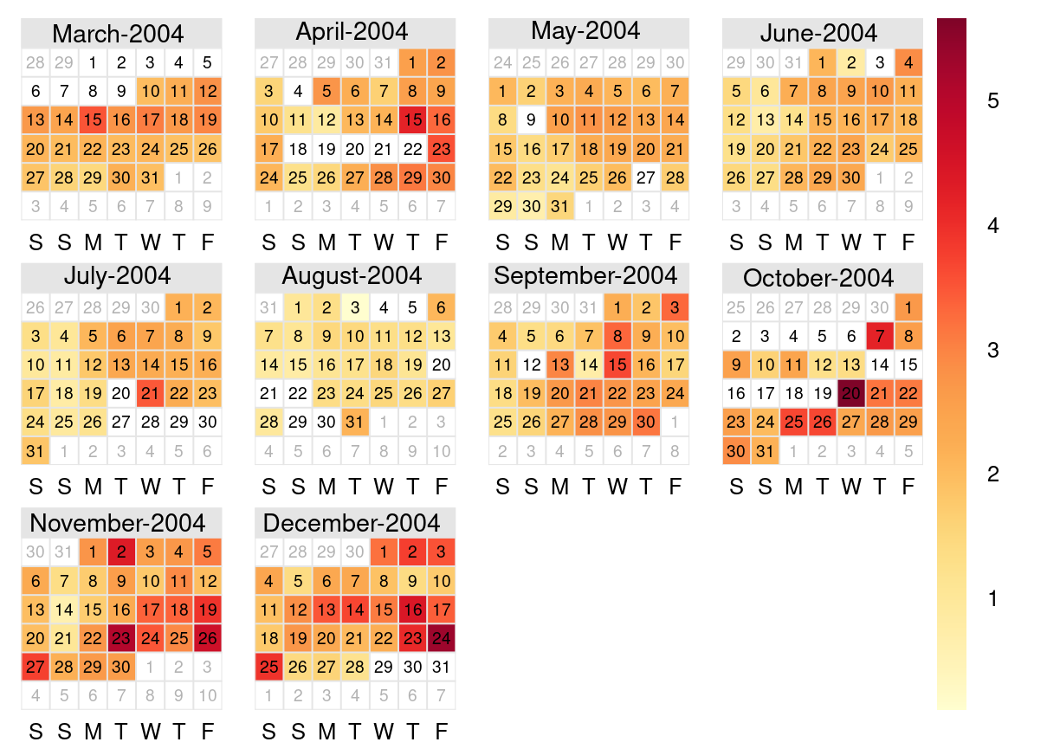
Measurement Details CO Example
UCI Air Quality Study 1
Measure Phase
Fig.: Plot of reference concentration CO ground truth data. Calendar plot on the left and time variation on the right.

Slide 23
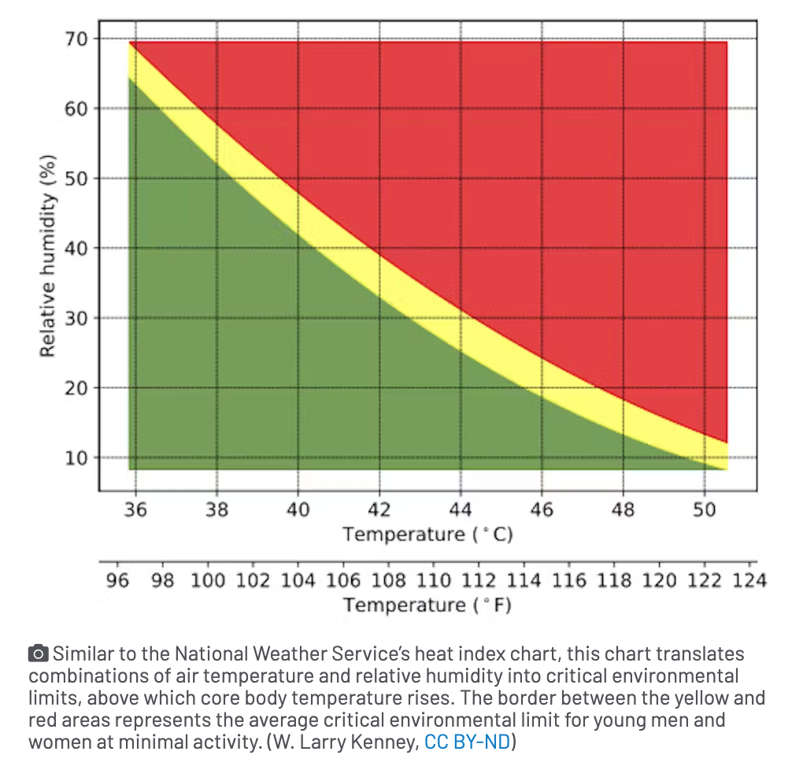
Humans are very sensitive to humidity
UCI Air Quality Study 1
Measure Phase
Fig.: Relative humidity and temperature threshold.

Slide 24
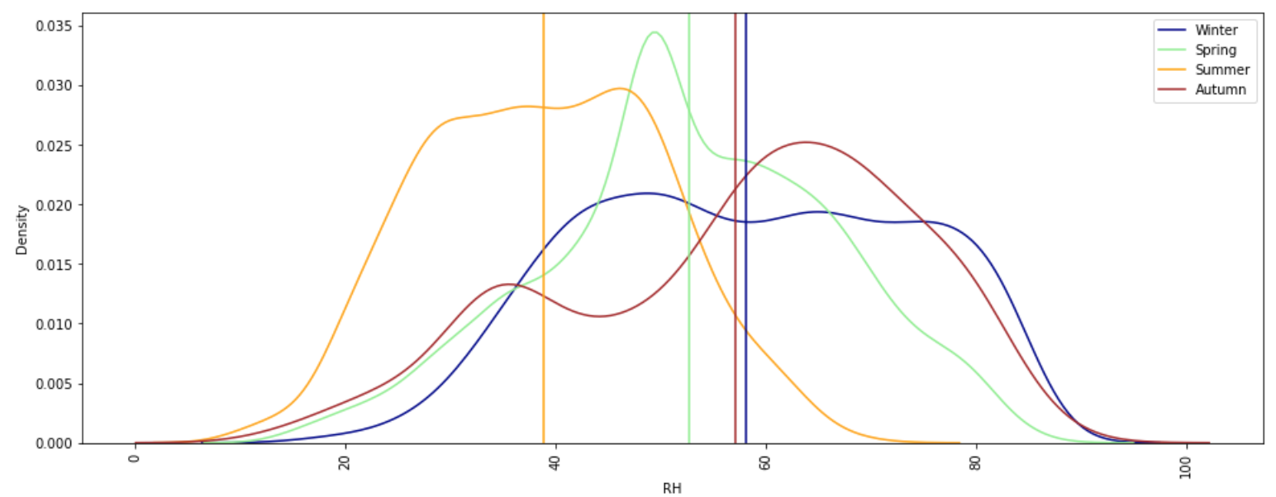
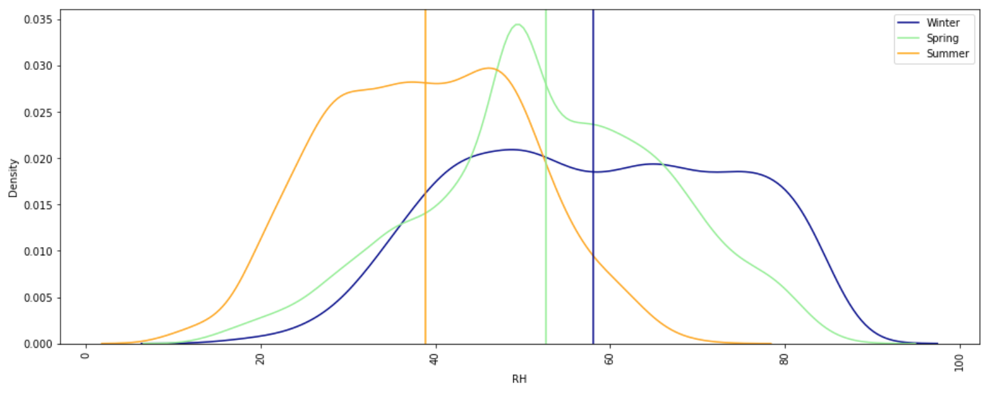
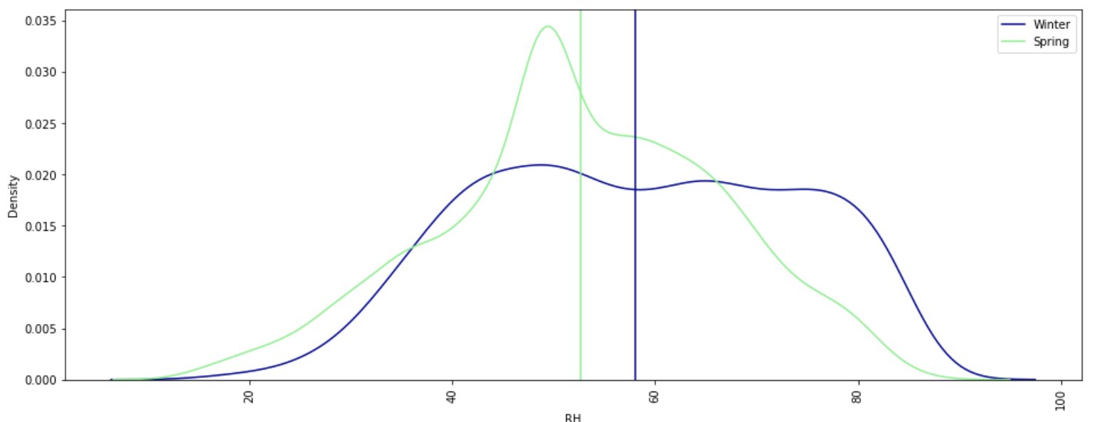
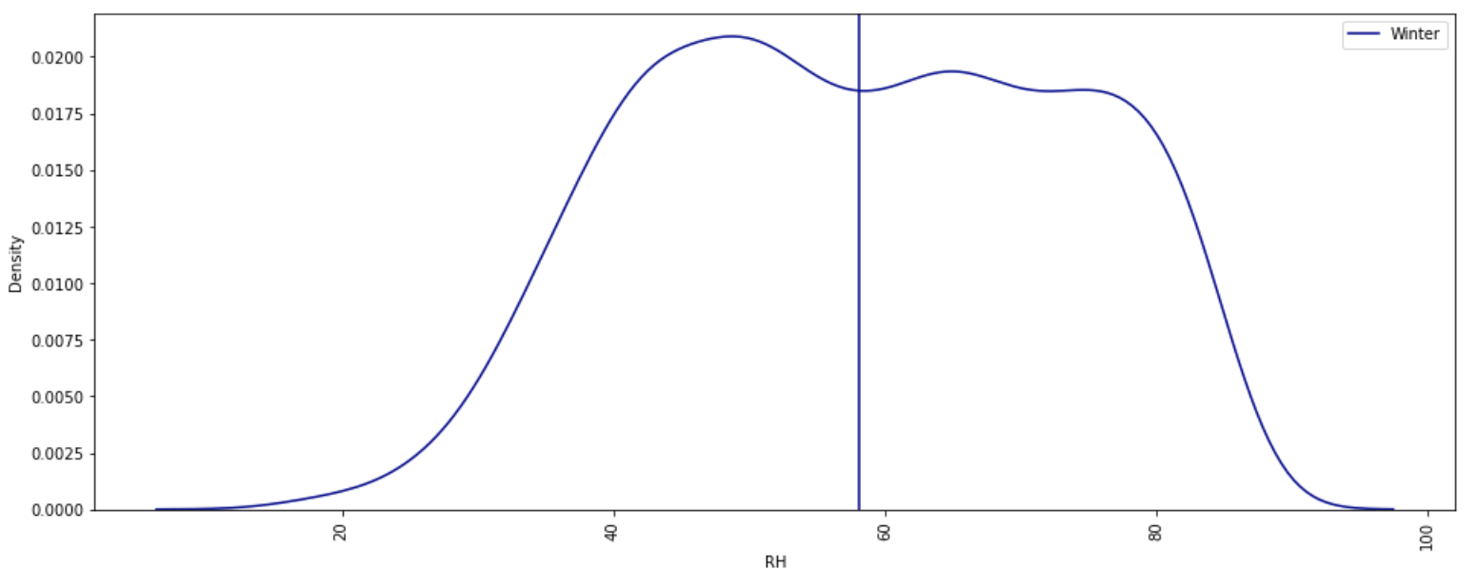
Relative Humidity is inverse correlated with temperature
UCI Air Quality Study 1
Measure Phase

Slide 25
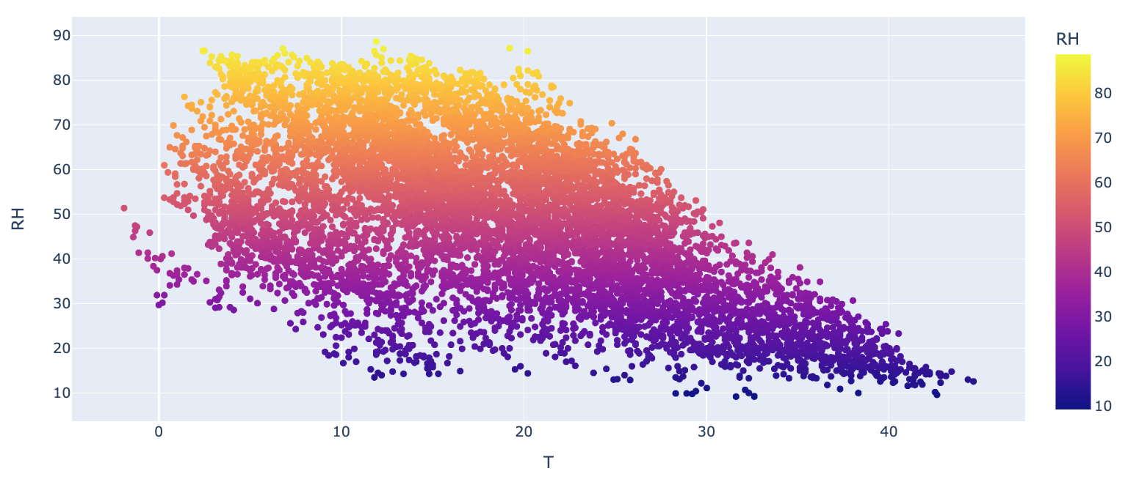
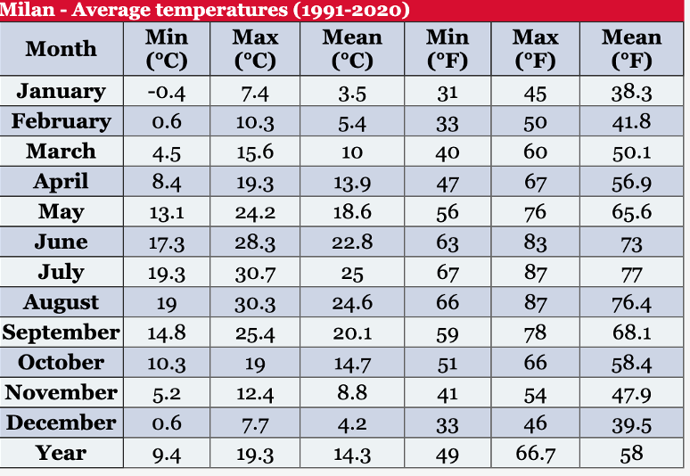
Relation between relative humidity and temperature
Fig 1.: This scatterplot is showing that more the temperature, lesser the relative humidity. It means relative humidity is indirectly proportional to the temperature.
Fig 2.: Our assumed temperature reference for the seasons. North Italy, Milan.
UCI Air Quality Study 1
Measure Phase

Slide 26
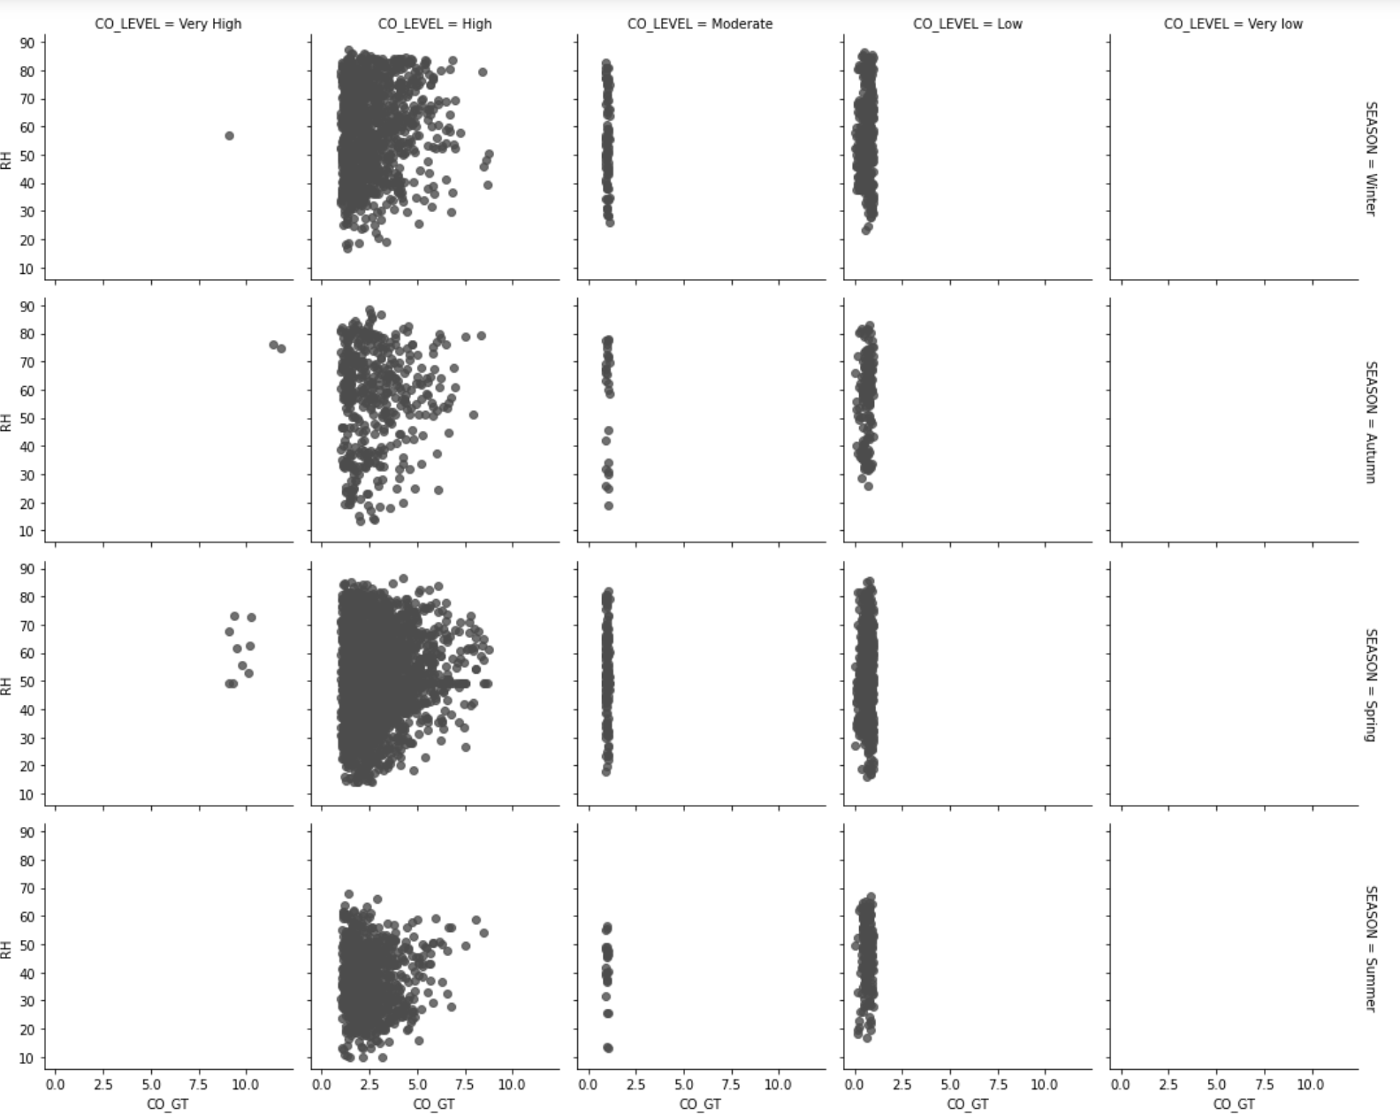
Summary of RH in relation to AQ
Fig: This scatterplot is shows RH relative to AQ pollutants and displayed along the seasons. Example CO.

Slide 27
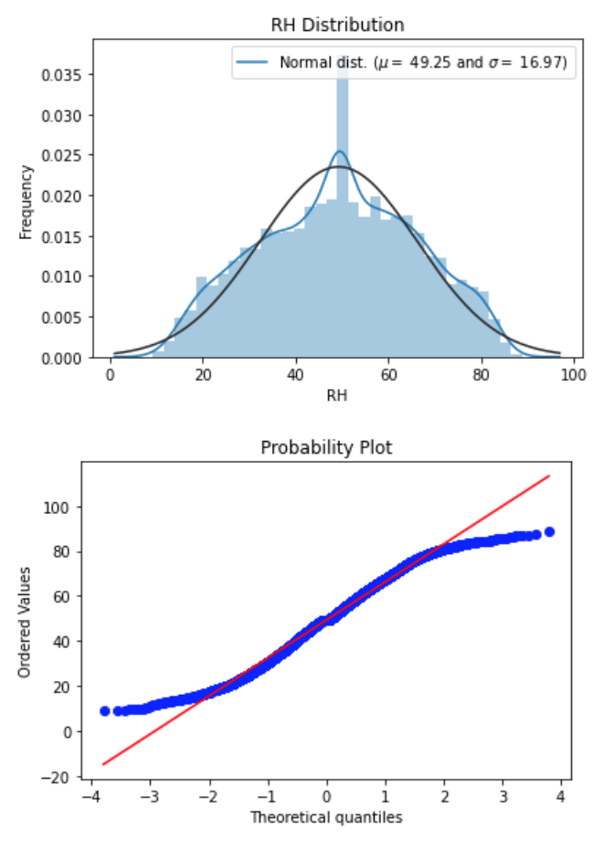
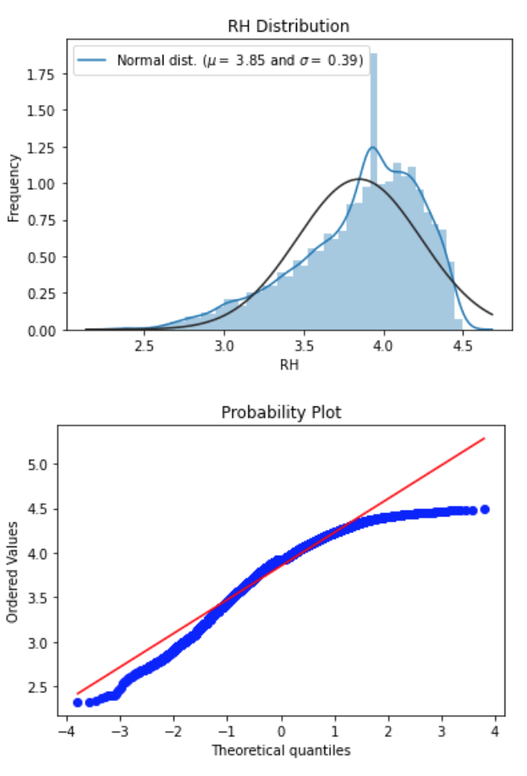
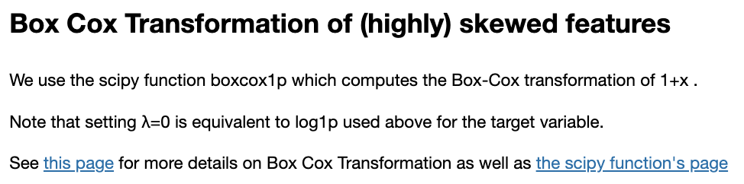

Slide 28

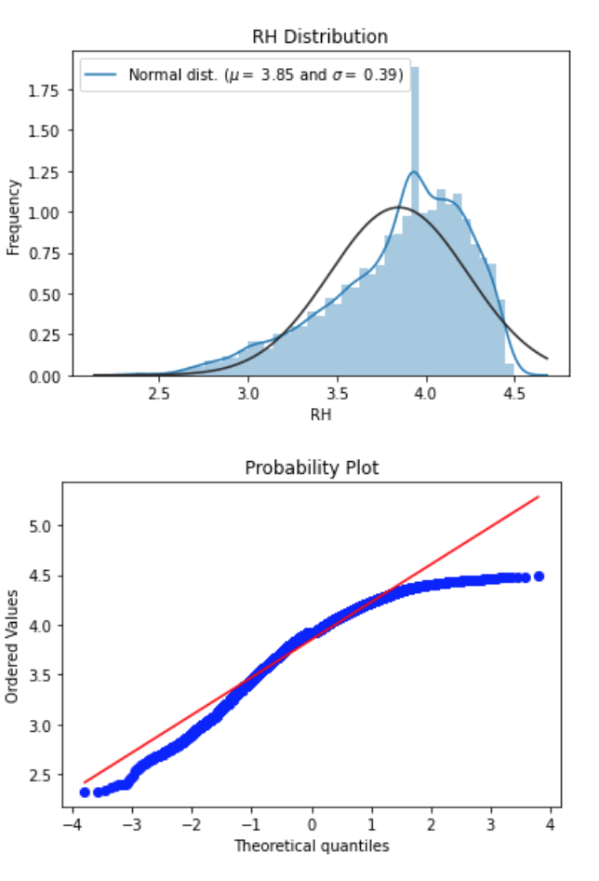
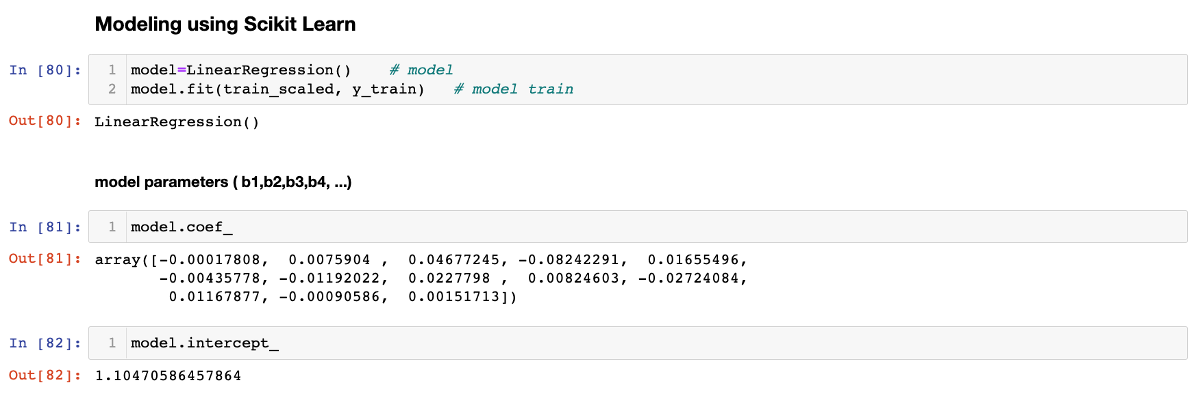
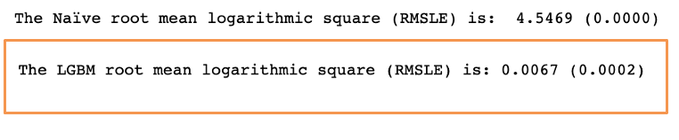
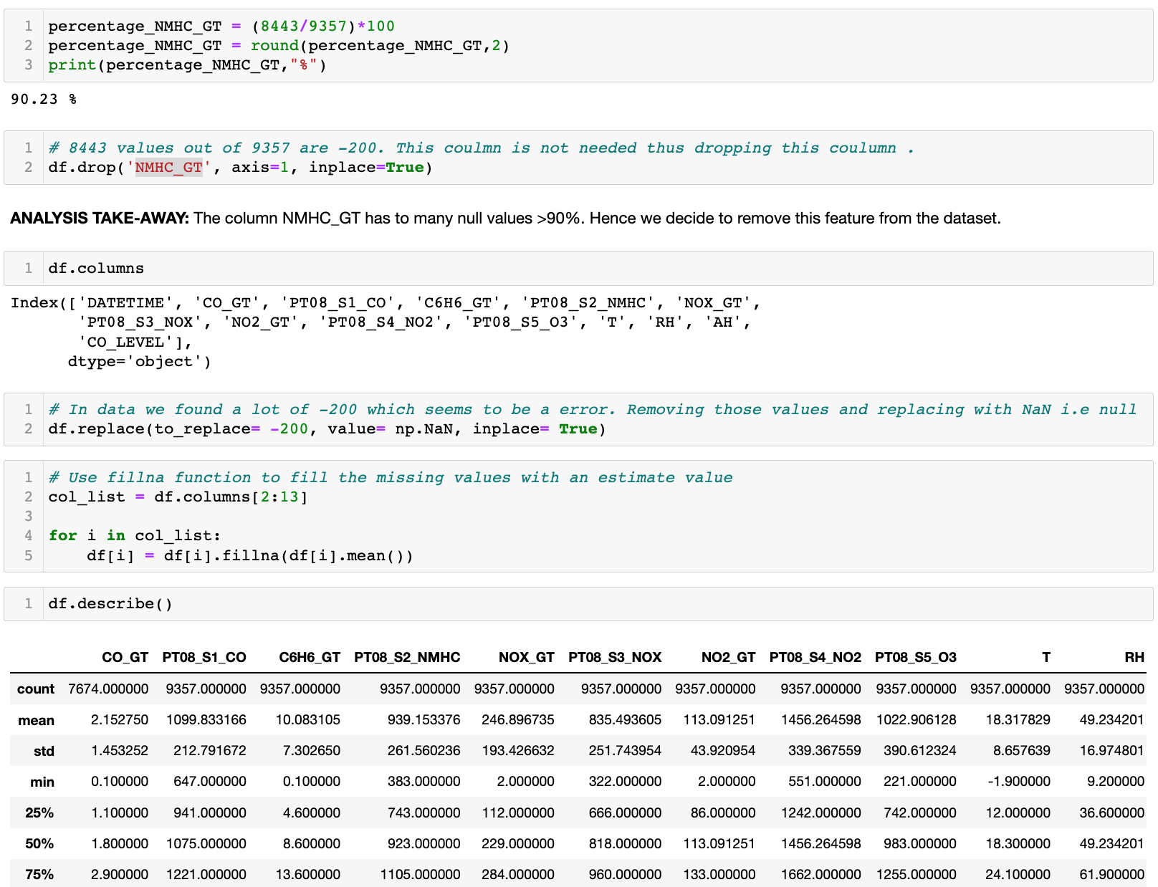
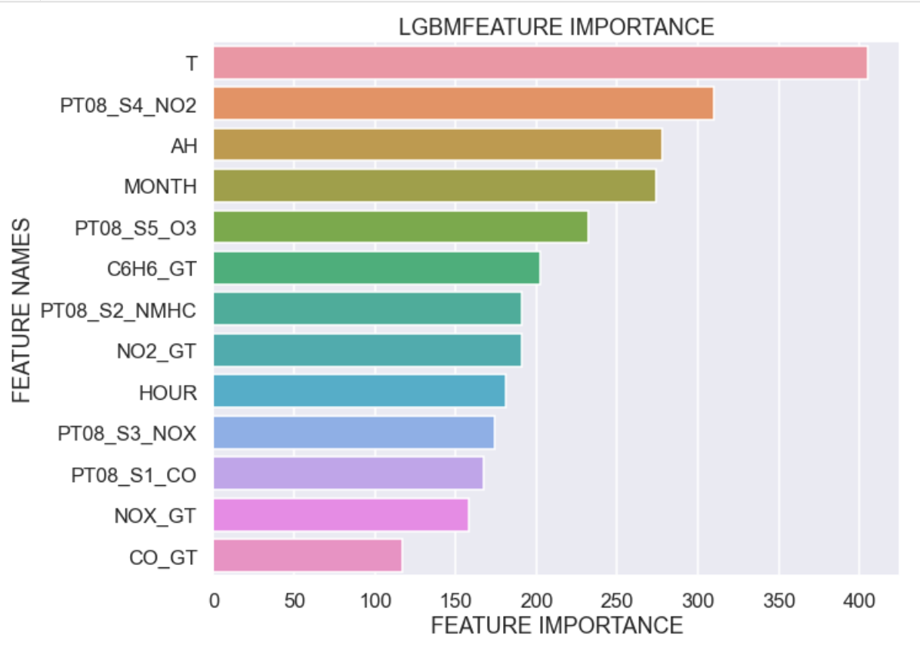
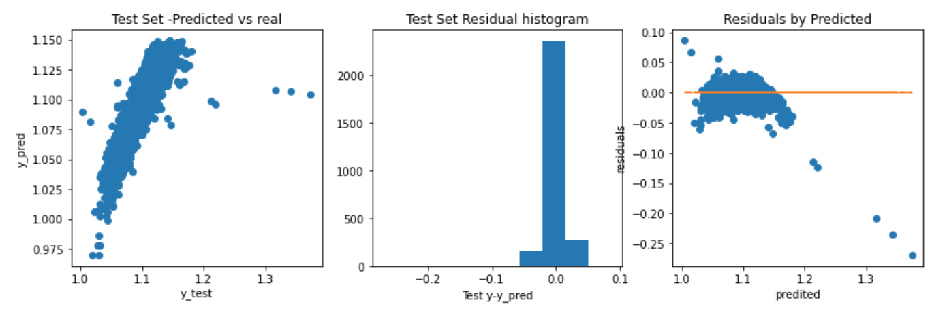
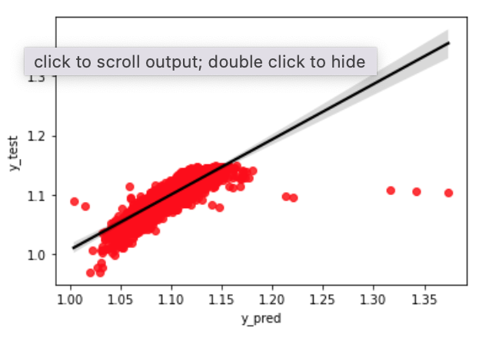
We used Python for analysis and Seaborn for visualization
1
Data cleaning
2
Data preparation
3
Modeling in
4
Visualization
Remove redundant columns
Consolidate weekly data
Coerce data types
Create new variables
Log transformation
Combine macro data
Create subsets
Plot regression charts
Run Regressions
Regression outputs
Aggregation charts
Observation & analysis

Slide 29
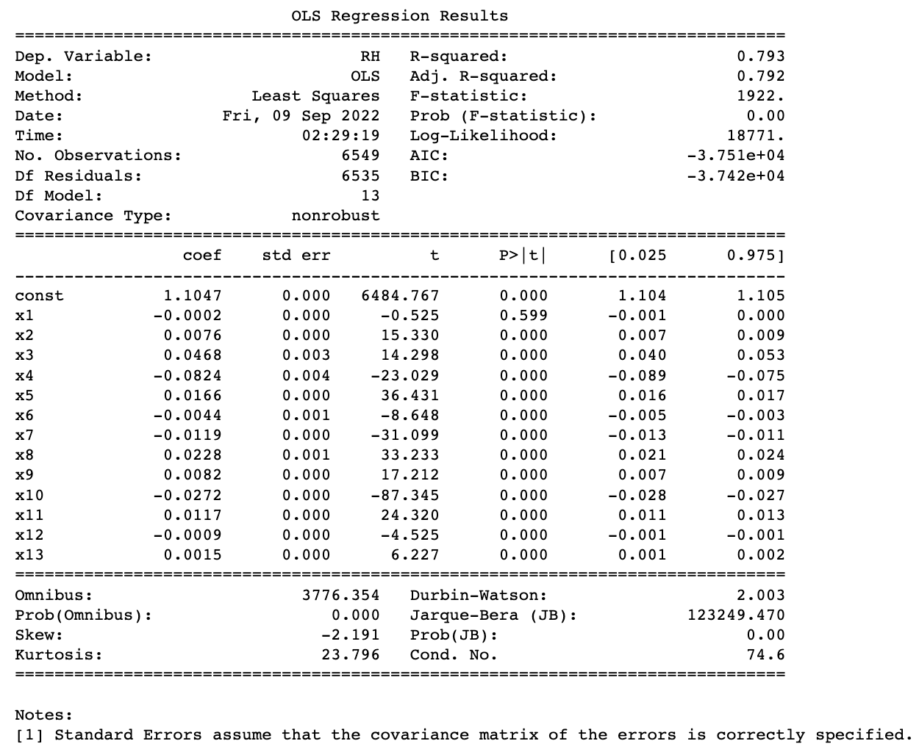
Naïve Linear Regression Modell
UCI Air Quality Study 2
Analyze Phase
LINEAR REGRESSION MODEL

Slide 30
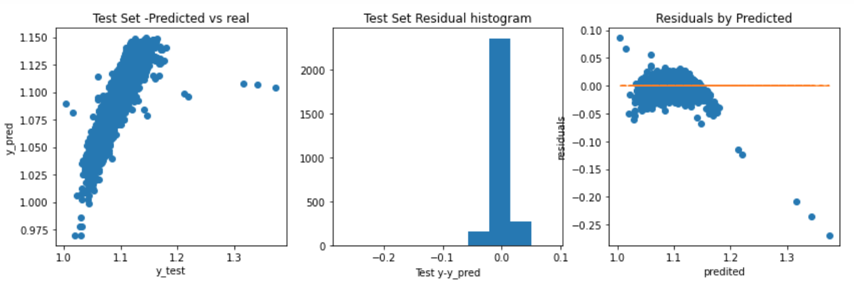
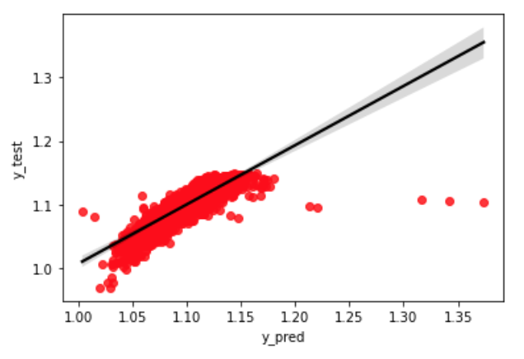
Naïve Linear Regression Modell Cont`
UCI Air Quality Study 2
Analyze Phase
LINEAR REGRESSION MODEL

Slide 31
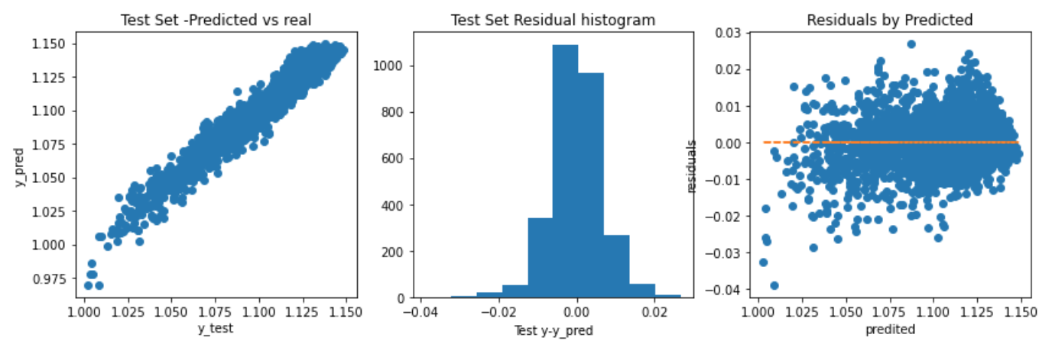
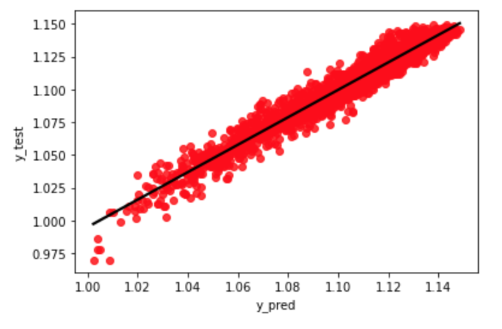

LightGBM (Microsoft) Regression Modell
UCI Air Quality Study21
Analyze Phase

Slide 32


Decision on Champion Model
UCI Air Quality Study 2
Analyze Phase
Initial results back on Test set hitting F1 score of 0.88 – well above the 0.5 threshold set earlier.
Smart Objective Met?
We will predict the Relative Humidity of a given point of time based on the all other attributes affecting the change in RH from the UCI AQ dataset, improving Naïve linear regression baseline performance by 20% using ensemble models.
Improvement from Naïve linear regression baseline
(LGBM_RMSLE/Naïve_RMSLE)% = 85.26% YES!

Slide 33
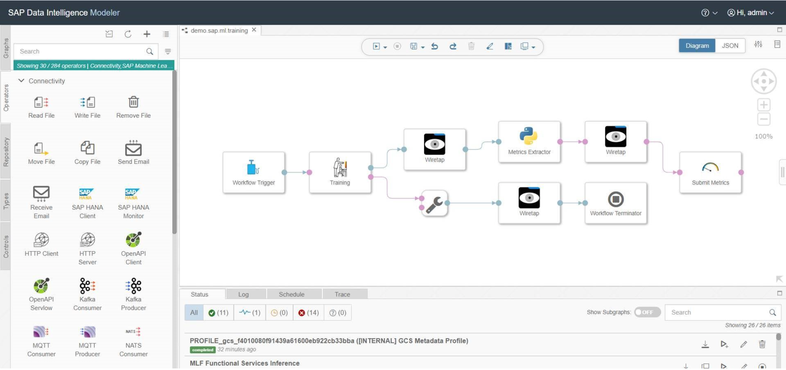
Deployment on SAP Data Intelligence
UCI Air Quality Study 2
Control Phase

Slide 34
UCI BEIJING AIR QUALITY MULTIVARIATE REGRESSION TENSORFLOW LSTM
IRONHACK DAFT AUG22 “Data Analytics” Midterm Project Presentation
Team Member: Rodrigo Franco, Gunnar David
CONFIDENTIAL

Slide 35
Contents
Project Overview
Objective
Data preview
Analytics Roadmap
Analysis process
Key Findings
Regression models
Output
Visualization
Observations
Recommendations

Slide 36
Project Overview

Slide 37
Overview BIG Questions
How does air pollution (“pollution”) changes statistically and linearly with the temperature, wind drift?
What important factors impact air quality and how?
How would the air pollution deep learning model such as LSTM scale with AQ big data? Is the LSTM regression model sufficient for the objective?
What is the optimal predictive model for air pollution from AQ data?

Slide 38
Introduction to the Research
UCI Air Quality Study
Define Phase
Study 1: Exploration & Visualization of the UCI AQ Dataset
Objective:
In this study on the UCI Air Quality dataset , we have done an in-depth analysis and visualization on the air quality dataset. The goal is to find the patterns and relationships in the dataset.
Rodrigo Franco and Gunnar David analyze the UCI Air Quality (AQ) Dataset qualitatively and quantitatively. We will clean, wrangle and visualize the data. This study aims to understand better the impact of the explanatory variables on air pollution. The sensor data was recorded in Italy from March 2004 to February 2005 (one year) [UCI AQ Dataset](https://archive.ics.uci.edu/ml/datasets/air+quality).
Summary report: UCI AQ Data Analysis Report

Slide 39
Introduction to the Research
UCI Air Quality Study
Define Phase
Study 2: Univariate Regression Model for Relative Humidity
Problem:
Humans are very sensitive to humidity, as the skin relies on the air to get rid of moisture. The process of sweating is your body's attempt to keep cool and maintain its current temperature. If the air is at 100-percent relative humidity, sweat will not evaporate into the air. As a result, we feel much hotter than the actual temperature when the relative humidity is high. If the relative humidity is low, we can feel much cooler than the actual temperature because our sweat evaporates easily, cooling us off. For example, if the air temperature e is 75 degrees Fahrenheit (24 degrees Celsius) and the relative humidity is zero percent, the air temperature feels like 69 degrees Fahrenheit (21 C) to our bodies. If the air temperature is 75 degrees Fahrenheit (24 C) and the relative humidity is 100 percent, we feel like it's 80 degrees (27 C) out.
Background:
In the last few years, the interest in the development of new pervasive or mobile implementations of air quality multisensor devices has significantly grown. New application opportunities appeared together with new challenges due to limitations in dealing with rapid pollutants concentrations transients both for static and mobile deployments. In this work, we propose a Naïve linear model approach for the prediction of relativ humidity & temperature by means of pollutant detection & sensing with chemical multisensor devices. Esposito et.al., 2016 ^{[1]}
Main Question here:
How does relative humidity changes relative to the air pollutants concentration?
Does the regressor estimator model bag perform better when we have a larger dataset, more complex features, i.e, big data (a.k.a. is the model scalable)?
Do simpler regression modules perform well/ robust for small amount of data (why, i.e. variance/bias)? Does it generalizes & scale generally well into the big-data domain?
^{[1]}Esposito, Elena & De Vito, Saverio & Salvato, Maria & Bright, Vivien & Jones, R.L. & Popoola, Olalekan. (2016). Dynamic Neural Network Architectures for on field stochastic calibration of indicative low cost air quality sensing systems. Sensors and Actuators B: Chemical. 231. 10.1016/j.snb.2016.03.038.

Slide 40
Smart Objective
UCI Air Quality Study
Define Phase
We will predict the air pollution time series by from the UCI Beijing AQ dataset. The objective is to get an accurate predictive model for public harm prevention/ public hazard warning on AQ.
SVM will be the naïve multivariate regression baseline performance. Prediction time horizon aim is > 3h with acceptable RMSE threshold (compared to literature).
Also note that perhaps more than one machine learning model is required if results from a single model on all Relative Humidity is not effective.

Slide 41
Smart Objective - Context
UCI Air Quality Study
Define Phase
Air pollution CO2 emission and further pollutants should be accounted for in an energy consumption balance and visualization.
Awareness should be raised for net-zero targets in the digital business transformation and the role of smart and green coding.
Also note that perhaps more than one machine learning model is required if results from a single model on all Relative Humidity is not effective.

Slide 42
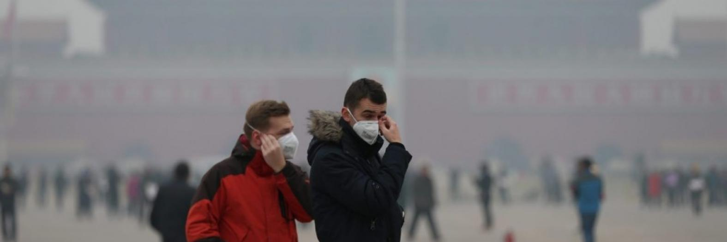

UCI Air Quality Study
Define Phase
1 Abstract
Air pollution in urban environments has risen steadily in the last several decades.
Such cities as Beijing and Delhi have experienced rises to dangerous levels for citizens.
As a growing and urgent public health concern, cities and environmental agencies have been exploring methods to forecast future air pollution, hoping to enact policies and provide incentives and services to benefit their citizenry.
Refrence: [1] https://www.ischool.berkeley.edu/sites/default/files/sproject_attachments/deep-air-forecasting_final.pdf, accessed 15.09.2022 15:32:00

Slide 43
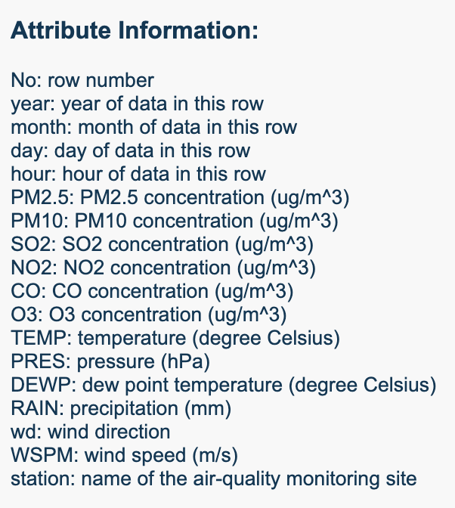
UCI Air Quality Study
Define Phase
Reference [2]: https://archive.ics.uci.edu/ml/datasets/Beijing+Multi-Site+Air-Quality+Data

Slide 44
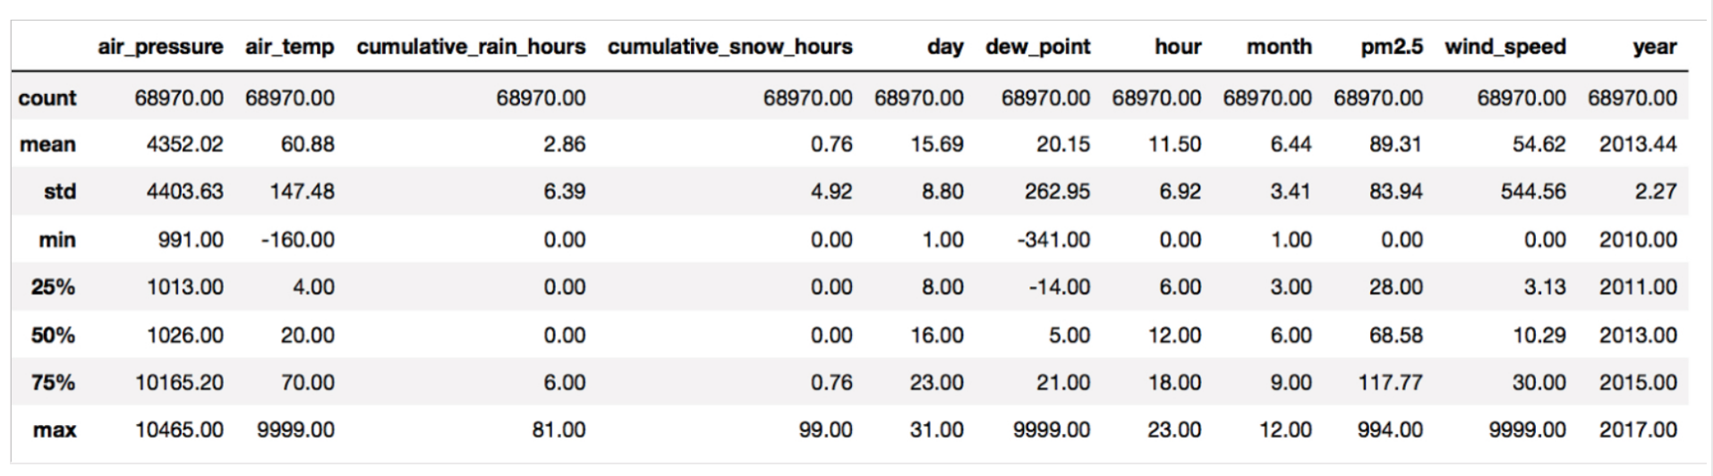
Reference [3]: https://www.ischool.berkeley.edu/sites/default/files/sproject_attachments/deep-air-forecasting_final.pdf

Slide 45
UCI Air Quality Study
Define Phase
2 Introduction
Due to rapid industrialization, the twentieth century was the most environmentally unfriendly period of time in the history of humanity.
The proliferation of nonrenewable energy sources, such as coal, as well as the global rise of the gasolinepowered automobile, created dangerously high levels of greenhouse gas emissions.
The United Nations states that today over 54% of the world’s population lives in urban areas, and it is anticipated to increase to 66% by 2050.
Reference [4]: David A Leon. “Cities, urbanization and health”. In: International Journal of Epidemiology 37.1 (2008), pp. 4–8. DOI: 10.1093/ije/dym271. eprint: /oup/backfile/content_public/journal/ije/37/1/10.1093/ ije/dym271/2/dym271.pdf. URL: +%20http://dx.doi.org/10.1093/ije/dym271.

Slide 46
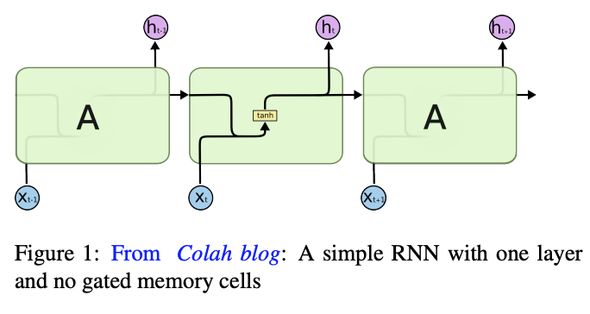
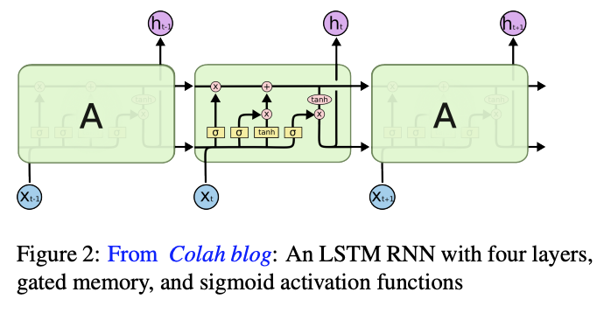
UCI Air Quality Study
Define Phase
3 Theoretical Background
g. LSTMs take as inputs not only the current input, but also what they have ”perceived” previously in time, essentially using the output at time t − 1 as an input to time t, along with the new input at time t. Given this, the network effectively has ’memory,’ unlike feedforward networks.
t the best predictor of future air pollution is previous air pollution over long time periods
Literature suggests LSTM RNNs to be most appropriately suited for the data.
Refrence [5]: Sepp Hochreiter and Jurgen Schmidhuber. “Long Short-Term Memory”. In: ¨ Neural Comput. 9.8 (Nov. 1997), pp. 1735– 1780. ISSN: 0899-7667. DOI: 10.1162/neco.1997.9.8.1735. URL: http://dx.doi.org/10.1162/ neco.1997.9.8.1735.

Slide 47
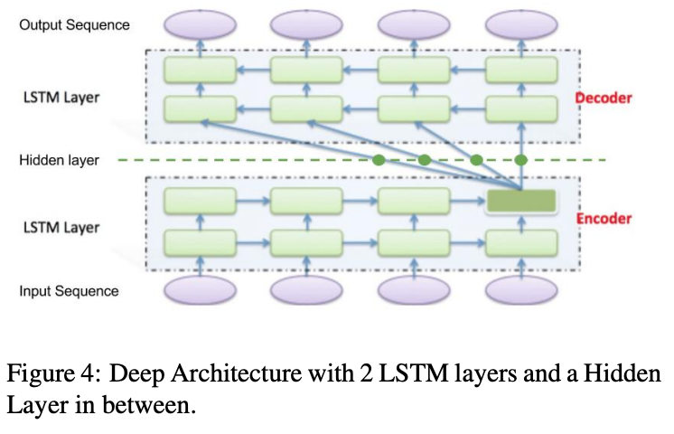
UCI Air Quality Study
Define Phase
LSTM Sequence to Sequence
This is the best performing deep learning model for the AQ prediction

Slide 48
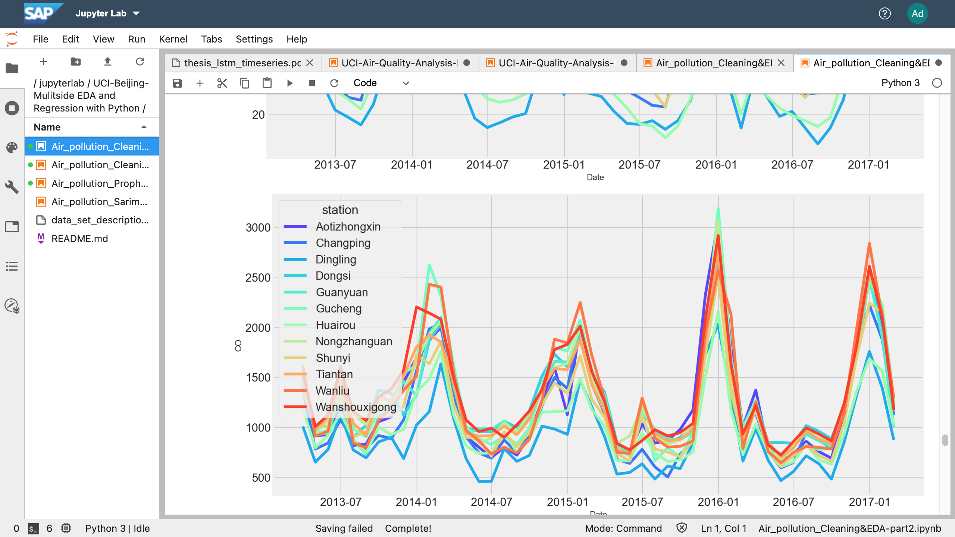
Exploratory Data Analysis
UCI Air Quality Study
Measure Phase
Please visit SAP DI
Air_pollution_Cleaning&EDA
for descriptive analsysis

Slide 49
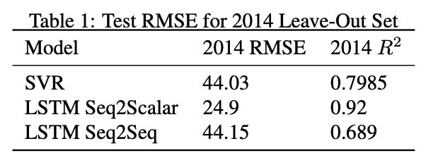



UCI Air Quality Study
Analyze Phase
4 Test Set Results

Slide 50




UCI Air Quality Study
4 Test Set Results Cont’
Analyze Phase

Slide 51
UCI Air Quality Study
Control Phase
2 Conclusion
Predicting air pollution accurately up to ten hours in advance can be extremely useful for city policy, and more specifically, for dynamic public transit pricing.
If such a city as Beijing could predict in the morning that air pollution would be dangerously high in the evening, then it could encourage public transit use by decreasing fares for that day or by dynamically enacting road congestion pricing for the evening rush hour to discourage driving.

Slide 52


"We see that we are able to forecast pollution within the same error margin as prediction for a single future time-step.”
"LSTMs are a good model given the scope of the data we obtained, since they preserve the errors in a gated cell”
"Given this results that we can predict air pollution accurately up to ten hours in advance, this can be extremely useful for city policy, and more specifically, for dynamic public transit pricing.”
"In addition, the results of this paper can help in the management of deployed sensors, primarily in decreasing power consumption. We can now help cities save money by keeping their sensors on only in six to ten hour increments, rather than 24/7..."

Slide 53
Deployment on SAP Data Intelligence
UCI Air Quality Study 2
Control Phase

Slide 54

thank you

